Slide 1


OCP 11 Part 1 [1Z0-819]
Dr.-Ing Mohamed Amine MEZGHICH
Associate Professor at ENSI, CEO of Smart IT Partner
JAVA/J2EE Certified Trainer
ma.mezghich@smart-it-partner.com
amine.mezghich@ensi-uma.tn

Slide 2
Chapter 7 :Modules
OCP exam objectives covered in this chapter: Understanding Modules Describe the Modular JDK Declare modules and enable access between modules Describe how a modular project is compiled and run
Link for source code : https://github.com/boyarsky/sybex-1Z0-815-chapter-11

Slide 3
Chapter 7:Modules
Since Java 9, packages can be grouped into modules. In this chapter, we will explain the purpose of modules and how to build your own. We will also show how to run them and how to discover existing modules. This book only covers the basics of modules that you need to know for the 1Z0-815 exam. We’ve made the code in this chapter available online. Since it can be tedious to create the directory structure, this will save you some time. Additionally, the commands need to be exactly right, so we’ve included those online so you can copy and paste them and compare them with what you typed. Both are available in the resources section of the online test bank and in our GitHub repo linked to from: http://www.selikoff.net/ocp11-1

Slide 4
1-Introducing Modules
A real project will consist of hundreds or thousands of classes grouped into packages. These packages are grouped into Java archive (JAR) files. A JAR is a zip file with some extra information, and the extension is .jar.
The Java Platform Module System (JPMS) was introduced in Java 9 to group code at a higher level and tries to solve the problems that Java has been plagued with since the beginning. The main purpose of a module is to provide groups of related packages to offer a particular set of functionality to developers.
It’s like a JAR file except a developer chooses which packages are accessible outside the module. Let’s look at what modules are and what problems they are designed to solve.

Slide 5
1-Introducing Modules
The Java Platform Module System includes the following: 1-A format for module JAR files 2-Partitioning of the JDK into modules 3-Additional command-line options for Java tools

Slide 6
1-Introducing Modules
1- Exploring a Module
A module is a group of one or more packages plus a special file called module-info .java. Figure 11.1 lists just a few of the modules a zoo might need. We decided to focus on the animal interactions in our example. The full zoo could easily have a dozen modules. In Figure 11.1, notice that there are arrows between many of the modules. These represent dependencies where one module relies on code in another. The staff needs to feed the animals to keep their jobs.
The line from zoo.staff to zoo.animal.feeding shows the former depends on the latter.

Slide 7
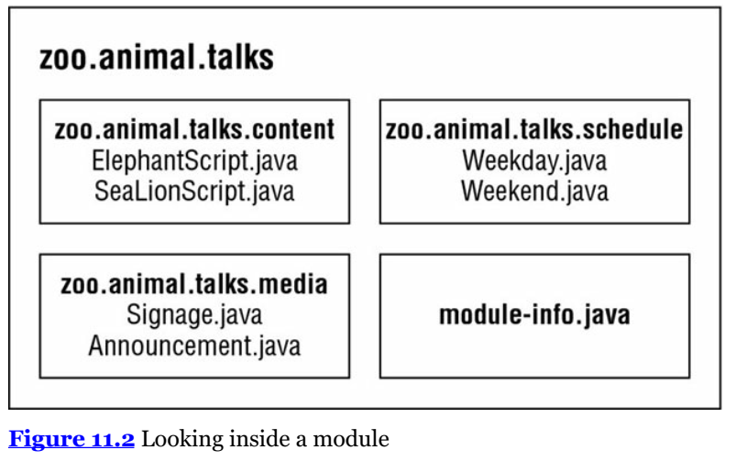
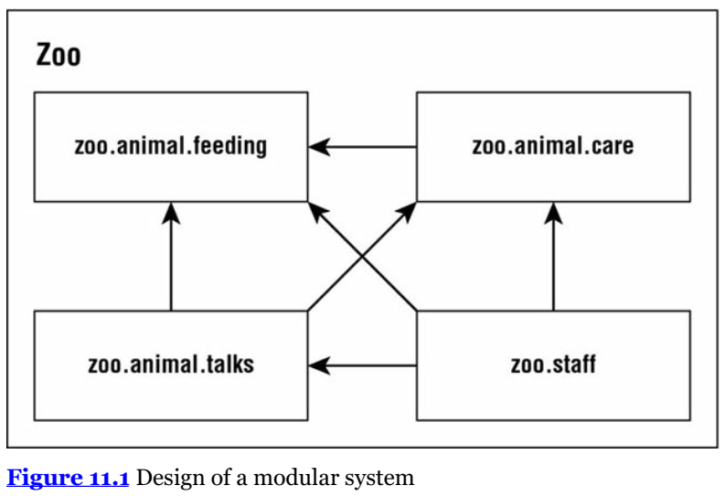
1-Introducing Modules
1- Exploring a Module

Slide 8
1-Introducing Modules
2- Benefits of Modules Modules look like another layer of things you need to know in order to program. While using modules is optional, it is important to understand the problems they are designed to solve. Besides, knowing why modules are useful is required for the exam! 2-1) Better Access Control Modules solve this problem by acting as a fifth level of access control. They can expose packages within the modular JAR to specific other packages. This stronger form of encapsulation really does create internal packages. You’ll see how to code it when we talk about the module-info.java file later in this chapter.

Slide 9
1-Introducing Modules
2-2) Clearer Dependency Management In a fully modular environment, each of the open source projects would specify their dependencies in the module-info.java file. 2-3) Custom Java Builds The Java Platform Module System allows developers to specify what modules they actually need. This makes it possible to create a smaller runtime image that is customized to what the application needs and nothing more. Users can run that image without having Java installed at all. A tool called jlink is used to create this runtime image. Luckily, you only need to know that custom smaller runtimes are possible. How to create them is out of scope for the exam.

Slide 10
1-Introducing Modules
2-4) Improved Performance Since Java now knows which modules are required, it only needs to look at those at class loading time. This improves startup time for big programs and requires less memory to run. While these benefits may not seem significant for the small programs we’ve been writing, they are far more important for big applications. A web application can easily take a minute to start. Additionally, for some financial applications, every millisecond of performance is important.
2-5) Unique Package Enforcement A package is only allowed to be supplied by one module. No more unpleasant surprises about a package at runtime. There’s a list of all Java modules on GitHub at https://github.com/sormuras/modules/blob/master/README.md. The 1Z0-816 exam covers some strategies for migrating existing applications to modules. For now, just beware that the 1Z0-815 exam covers just the simplest use cases for modules.

Slide 11
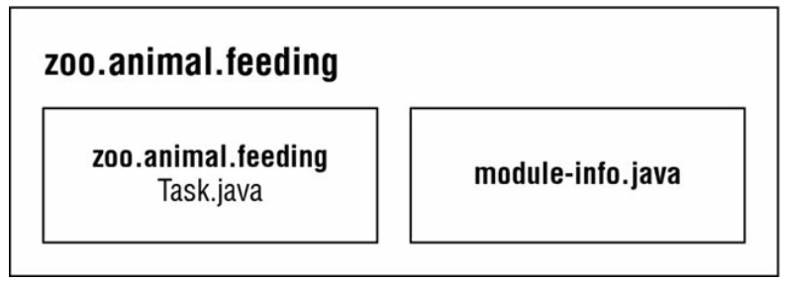
2-Creating and running a modular program
In this section, we will create, build, and run the zoo.animal.feeding module. We chose this one to start with because all the other modules depend on it. Figure 11.3 shows the design of this module. In addition to the module-info.java file, it has one package with one class inside.
In the next sections, we will create, compile, run, and package the zoo.animal.feeding module.

Slide 12
2-Creating and running a modular program
2-1) Creating the Files
So, let’s create a simple class.
package zoo.animal.feeding; public class Task { public static void main(String... args) { System.out.println("All fed!"); }}
Next comes the module-info.java file. This is the simplest possible

Slide 13
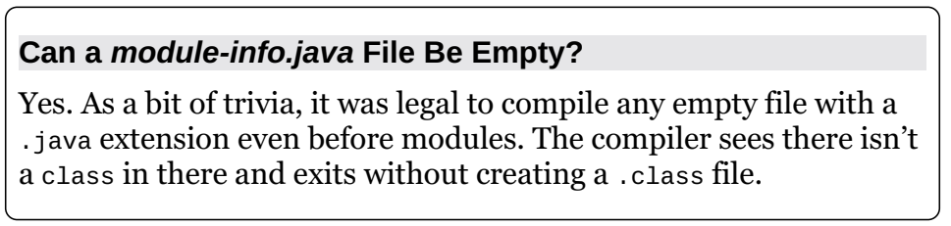
2-Creating and running a modular program
2-1) Creating the Files
module zoo.animal.feeding { }
There are a few key differences between a module-info file and a regular Java class: 1-The module-info file must be in the root directory of your module. Regular Java classes should be in packages. 2-The module-info file must use the keyword module instead of class, interface, or enum. 3-The module name follows the naming rules for package names. It often includes periods (.) in its name. Regular class and package names are not allowed to have dashes (-). Module names follow the same rule.

Slide 14
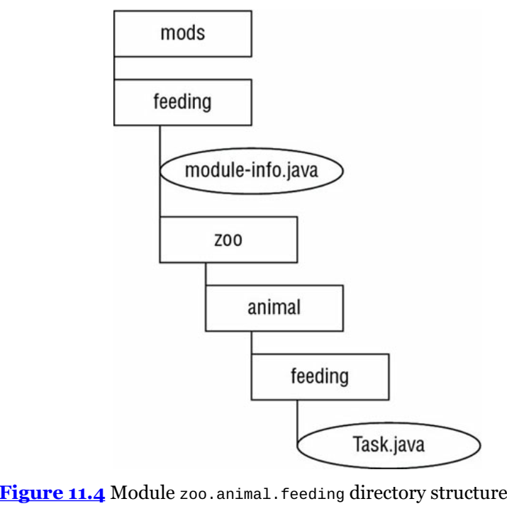
2-Creating and running a modular program
The next step is to make sure the files are in the right
directory structure. Figure 11.4 shows the expected
directory structure.

Slide 15
2-Creating and running a modular program
2-2) Compiling Our First Module Before we can run modular code, we need to compile it. Other than the module-path option, this code should look familiar from Chapter 1:
javac --module-path mods -d feeding feeding/zoo/animal/feeding/*.java feeding/module-info.java As a review, the -d option specifies the directory to place the class files in. The end of the command is a list of the .java files to compile. You can list the files individually or use a wildcard for all .java files in a subdirectory.

Slide 16
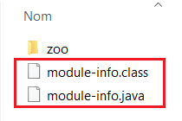
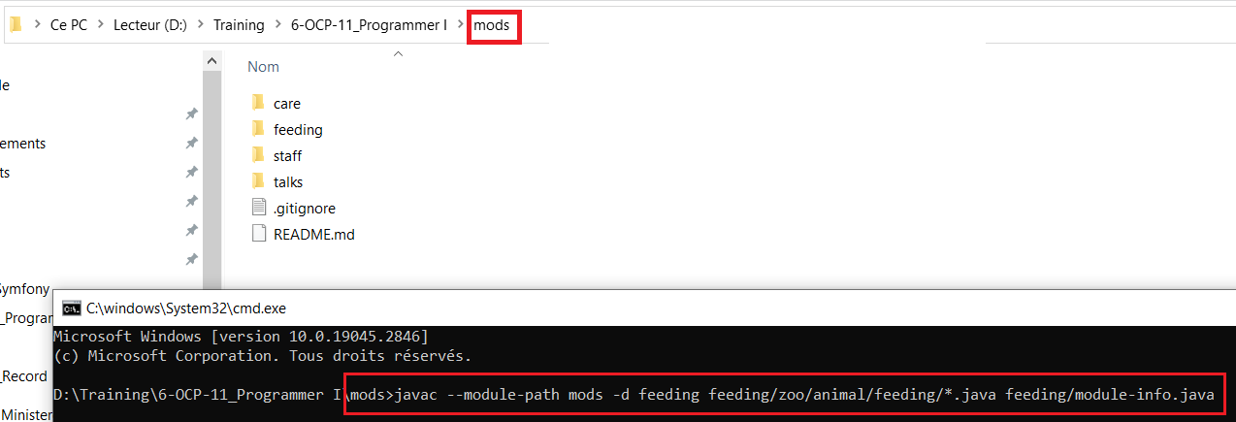
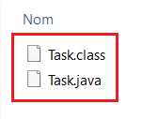
2-Creating and running a modular program
2-2) Compiling Our First Module

Slide 17
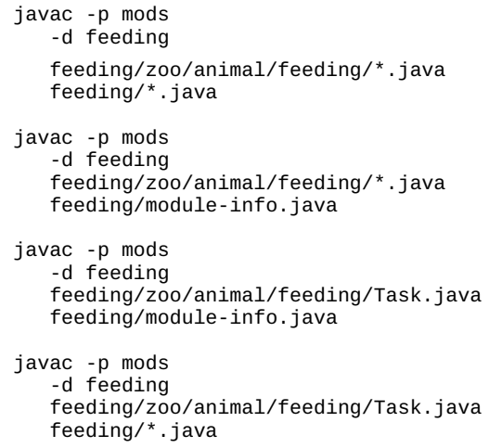
2-Creating and running a modular program
2-2) Compiling Our First Module Just like classpath, you can use an abbreviation
in the command. The syntax --module-path and
-p are equivalent. That means we could have
written many other commands in place of
the previous command. The following four
commands show the -p option:

Slide 18
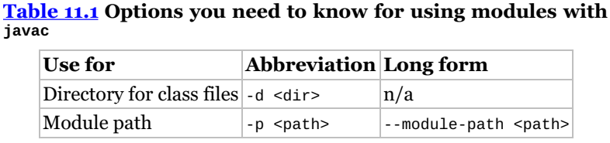
2-Creating and running a modular program
2-2) Compiling Our First Module While you can use whichever you like best, be sure that you can recognize all valid forms for the exam. Table 11.1 lists the options you need to know well when compiling modules. There are many more options you can pass to the javac command, but these are the ones you can expect to be tested on.

Slide 19
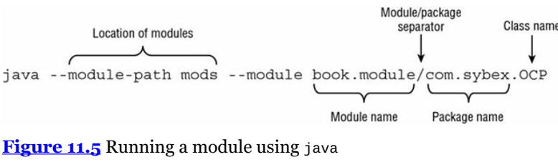
2-Creating and running a modular program
2-3) Running Our First Module Before we package our module, we should make sure it works by running it. To do that, we need to learn the full syntax. Suppose there is a module named book.module. Inside that module is a package named com.sybex, which has a class named OCP with a main() method. Figure 11.5 shows the syntax for running a module. Pay special attention to the book.module/com.sybex.OCP part. It is important to remember that you specify the module name followed by a slash (/) followed by the fully qualified class name.

Slide 20
2-Creating and running a modular program
2-3) Running Our First Module Now that we’ve seen the syntax, we can write the command to run the Task class in the zoo.animal.feeding package. In the following example, the package name and module name are the same. It is common for the module name to match either the full package name or the beginning of it. java --module-path feeding --module zoo.animal.feeding/zoo.animal.feeding.Task Since you already saw that --module-path uses the short form of -p, we bet you won’t be surprised to learn there is a short form of --module as well. The short option is -m. That means the following command is equivalent: java -p feeding -m zoo.animal.feeding/zoo.animal.feeding.Task

Slide 21
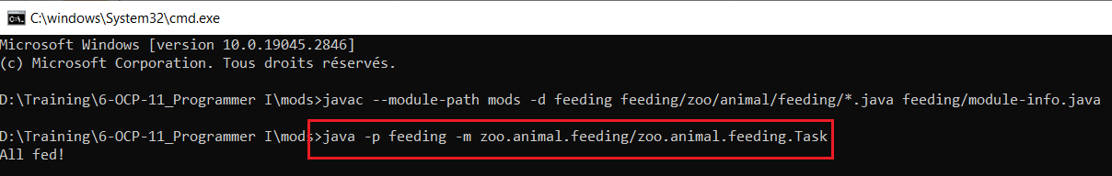
2-Creating and running a modular program
2-3) Running Our First Module java --module-path feeding --module zoo.animal.feeding/zoo.animal.feeding.Task java -p feeding -m zoo.animal.feeding/zoo.animal.feeding.Task

Slide 22
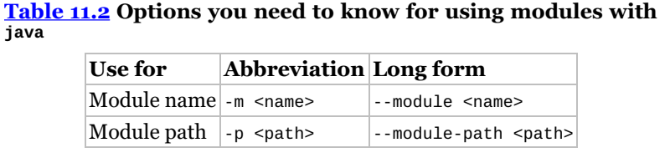
2-Creating and running a modular program
2-3) Running Our First Module In these examples, we used feeding as the module path because that’s where we compiled the code. This will change once we package the module and run that. Table 11.2 lists the options you need to know for the java command.

Slide 23
2-Creating and running a modular program
2-4) Packaging Our First Module Our next step is to package it. Be sure to create a mods(under mods) directory before running this command: jar -cvf feeding/zoo.animal.feeding.jar -C feeding/ . There’s nothing module-specific here. In fact, you might remember seeing this command in Chapter 1.
We are packaging everything under the feeding directory and storing it in a JAR file named zoo.animal.feeding.jar under the mods folder. This represents how the module JAR will look to other code that wants to use it. Now let’s run the program again, but this time using the mods directory instead of the loose classes: java -p mods -m zoo.animal.feeding/zoo.animal.feeding.Task

Slide 24
2-Creating and running a modular program
2-4) Packaging Our First Module You might notice that this command looks identical to the one in the previous section except for the directory. In the previous example, it was feeding. In this one, it is the module path of mods. Since the module path is used, a module JAR is being run. Figure 11.6 shows what the directory structure looks like now that we’ve compiled and packaged the code.

Slide 25
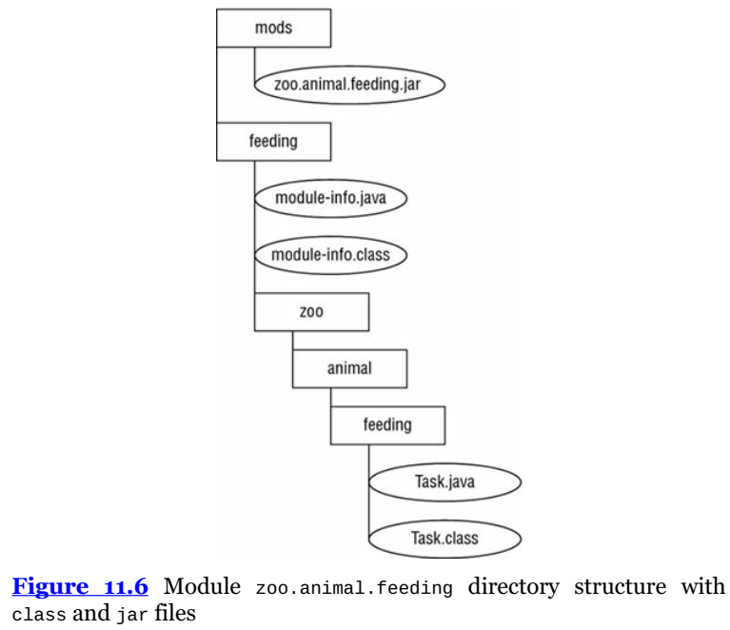
2-Creating and running a modular program
2-4) Packaging Our First Module

Slide 26
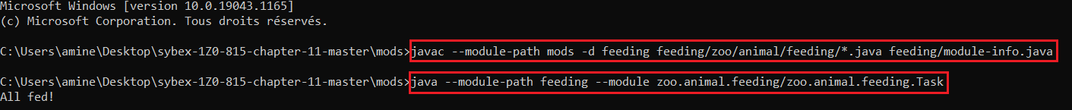
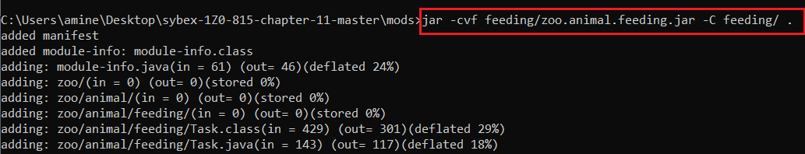
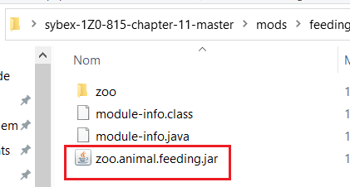
2-Creating and running a modular program
2-4) Packaging Our First Module

Slide 27
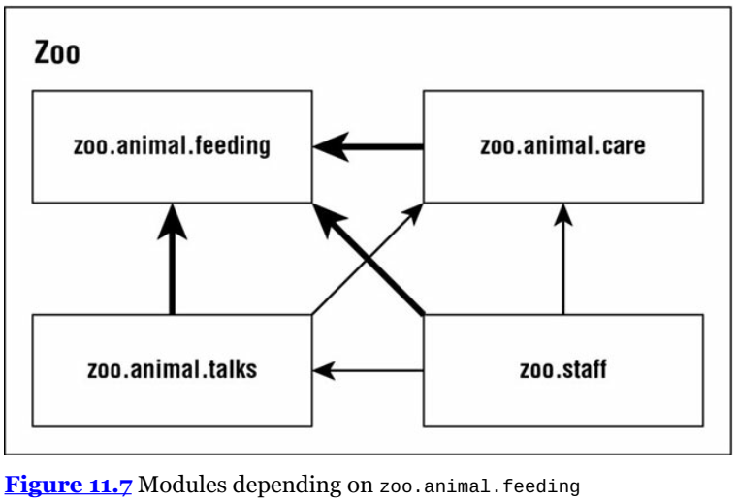
3-Multiples modules
Now that our zoo.animal.feeding module is solid, we can start thinking about our other modules. As you can see in Figure 11.7, all three of the other modules in our system depend on the zoo.animal.feeding module.

Slide 28
3-Multiples modules
3-1) Updating the Feeding Module
Since we will be having our other modules call code in the zoo.animal.feeding package, we need to declare this intent in the module-info file. The exports keyword is used to indicate that a module intends for those packages to be used by Java code outside the module. As you might expect, without an exports keyword, the module is only available to be run from the command line on its own. In the following example, we export one package:

Slide 29
3-Multiples modules
3-1) Updating the Feeding Module
module zoo.animal.feeding { exports zoo.animal.feeding; }
Recompiling and repackaging the module will update the module-info inside our zoo.animals.feeding.jar file. These are the same javac and jar commands you ran previously.
javac -p mods -d feeding feeding/zoo/animal/feeding/*.java feeding/module-info.java jar –cvf feeding/zoo.animal.feeding.jar -C feeding/ .

Slide 30
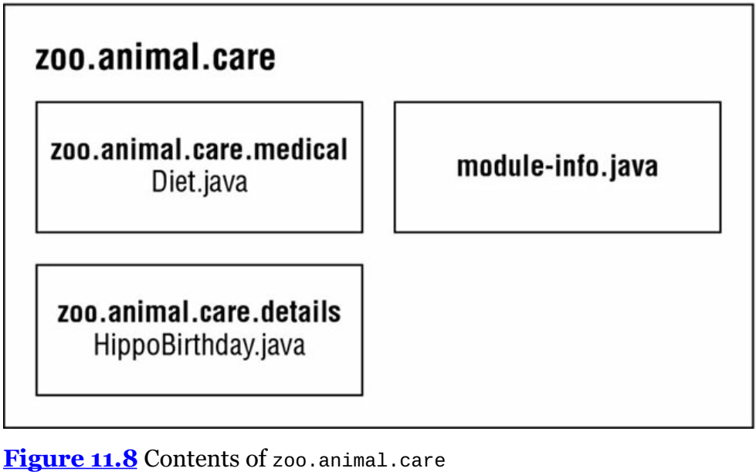
3-Multiples modules
3-2) Creating a Care Module

Slide 31
3-Multiples modules
3-2) Creating a Care Module
Next, let’s create the zoo.animal.care module. This time, we are going to have two packages. The zoo.animal.care.medical package will have the classes and methods that are intended for use by other modules. The zoo.animal.care.details package is only going to be used by this module. It will not be exported from the module. Think of it as healthcare privacy for the animals. Figure 11.8 shows the contents of this module. Remember that all modules must have a module-info file.

Slide 32
3-Multiples modules
3-2) Creating a Care Module
The module contains two basic packages and classes in addition to the module-info.java file:
// HippoBirthday.java package zoo.animal.care.details; import zoo.animal.feeding.*; public class HippoBirthday { private Task task; }
// Diet.java package zoo.animal.care.medical; public class Diet { } This time the module-info.java file specifies three things. 1: module zoo.animal.care { 2: exports zoo.animal.care.medical; 3: requires zoo.animal.feeding; 4: }
Line 1 specifies the name of the module. Line 2 lists the package we are exporting so it can be used by other modules. So far, this is similar to the zoo.animal.feeding module.

Slide 33
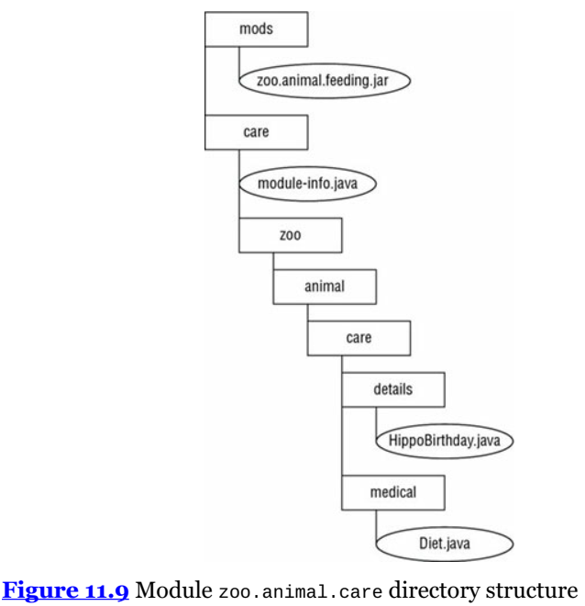
3-Multiples modules
3-2) Creating a Care Module
Figure 11.9 shows the directory structure of this module.
Note that module-info.java is in the root of the module.
The two packages are underneath it.

Slide 34
3-Multiples modules
3-2) Creating a Care Module
To review, we now compile and package the module: javac -p mods -d care care/zoo/animal/care/details/*.java care/zoo/animal/care/medical/*.java care/module-info.java
We compile both packages and the module-info file. In the real world, you’ll use a build tool rather than doing this by hand. For the exam, you just list all the packages and/or files you want to compile.

Slide 35
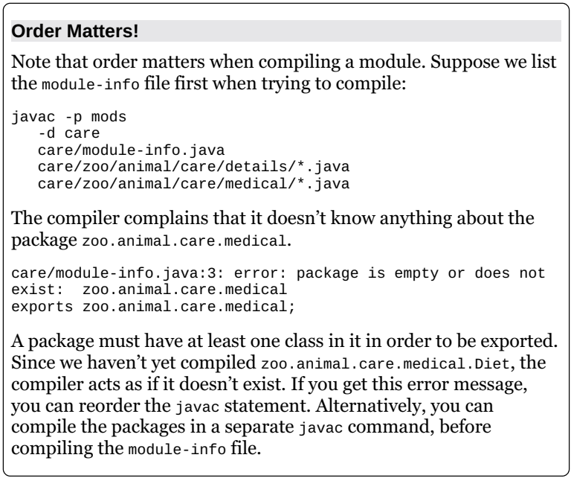
3-Multiples modules
3-2) Creating a Care Module
Now that we have compiled code,
it’s time to create the module JAR:
jar -cvf mods/zoo.animal.care.jar -C care/

Slide 36
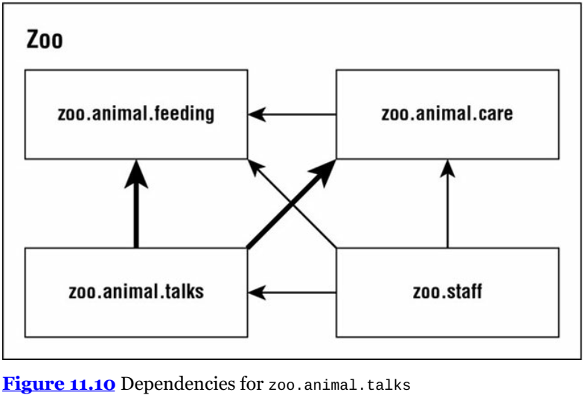
3-Multiples modules
3-3) Creating the Talks Module
So far, we’ve used only one exports and requires statement in a module. Now you’ll learn how to handle exporting multiple packages or requiring multiple modules. In Figure 11.10, observe that the zoo.animal.talks module depends on two modules: zoo.animal.feeding and zoo.animal.care. This means
that there must be two requires statements in the module-info.java file.

Slide 37
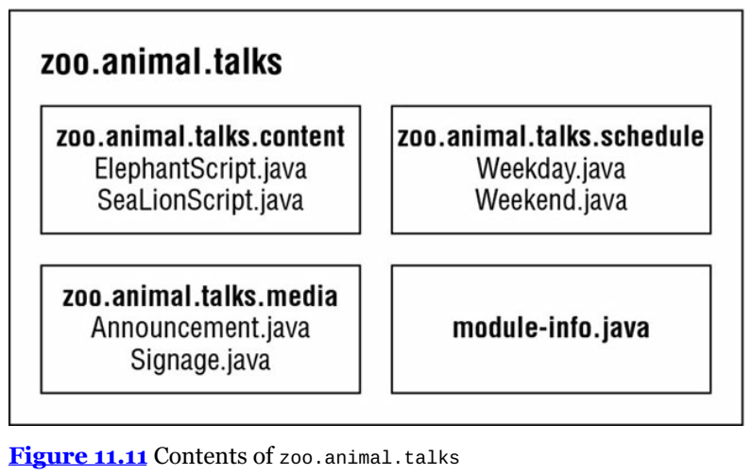
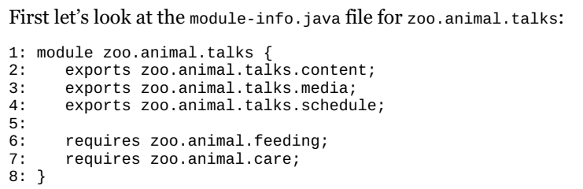
3-Multiples modules
3-3) Creating the Talks Module

Slide 38
3-Multiples modules
3-3) Creating the Talks Module
Line 1 shows the module name. Lines 2–4 allow other modules to reference all three packages. Lines 6–7 specify the two modules that this module depends on. Then we have the six classes, as shown here:
// ElephantScript.java package zoo.animal.talks.content; public class ElephantScript { } // SeaLionScript.java package zoo.animal.talks.content; public class SeaLionScript { }

Slide 39
3-Multiples modules
3-3) Creating the Talks Module
// Announcement.java package zoo.animal.talks.media; public class Announcement { public static void main(String[] args) { System.out.println("We will be having talks"); } }
// Signage.java package zoo.animal.talks.media; public class Signage { }
// Weekday.java package zoo.animal.talks.schedule; public class Weekday { } // Weekend.java package zoo.animal.talks.schedule; public class Weekend {}

Slide 40
3-Multiples modules
3-3) Creating the Talks Module
If you are still following along on your computer, create empty classes in the packages. The following are the commands to compile and build the module: javac -p mods -d talks talks/zoo/animal/talks/content/*.java talks/zoo/animal/talks/media/*.java talks/zoo/animal/talks/schedule/*.java talks/module-info.java jar -cvf mods/zoo.animal.talks.jar -C talks/ .

Slide 41
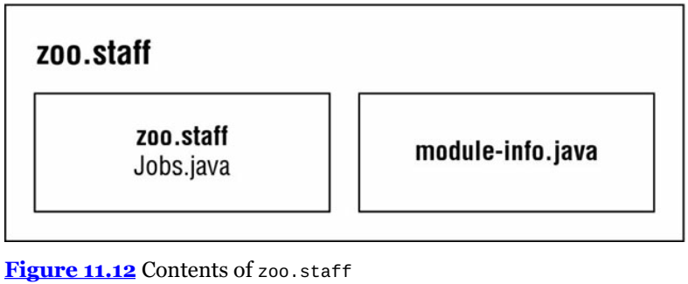
3-Multiples modules
3-4) Creating the Staff Module Our final module is zoo.staff. Figure 11.12 shows there is only one package inside. We will not be exposing this package outside the module.

Slide 42
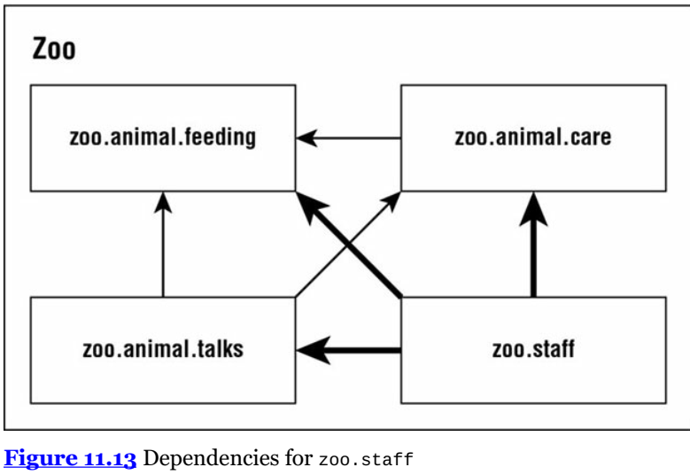
3-Multiples modules
3-4) Creating the Staff Module
Based on this information, do you know what should go in the moduleinfo? module zoo.staff { requires zoo.animal.feeding; requires zoo.animal.care; requires zoo.animal.talks; } There are three arrows in Figure 11.13 pointing from zoo.staff to other modules. These represent the three modules that are required. Since no packages are to be exposed from zoo.staff, there are no exports statements.

Slide 43
3-Multiples modules
3-4) Creating the Staff Module
In this module, we have a single class in file Jobs.java: package zoo.staff; public class Jobs { } For those of you following along on your computer, create an empty class in the package. The following are the commands to compile and build the module: javac -p mods -d staff staff/zoo/staff/*.java staff/module-info.java jar -cvf mods/zoo.staff.jar -C staff/ .

Slide 44
4-Diving into the Module info file
Now that we’ve successfully created modules, we can learn more about the module-info file. In these sections, we will look at exports, requires, provides, uses, and opens. Now would be a good time to mention that these keywords can appear in any order in the module-info file. exports We’ve already seen how exports packageName exports a package to other modules. It’s also possible to export a package to a specific module. Suppose the zoo decides that only staff members should have access to the talks. We could update the module declaration as follows:

Slide 45
4-Diving into the Module info file
module zoo.animal.talks { exports zoo.animal.talks.content to zoo.animal.staff; exports zoo.animal.talks.media; exports zoo.animal.talks.schedule; requires zoo.animal.feeding; requires zoo.animal.care; }

Slide 46
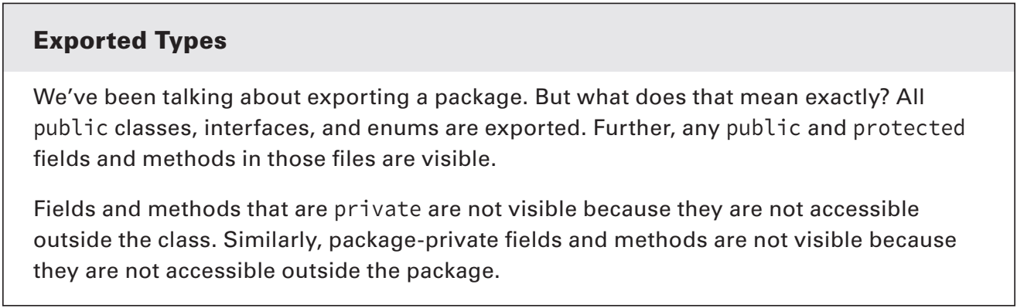
4-Diving into the Module info file

Slide 47
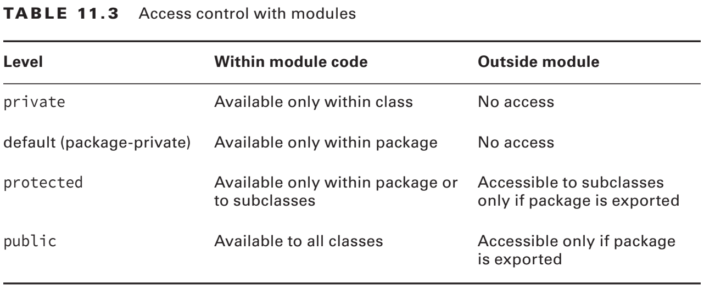
4-Diving into the Module info file

Slide 48
4-Diving into the Module info file
requires transitive As you saw earlier in this chapter, requires moduleName
specifies that the current module depends on moduleName.
There’s also a requires transitive moduleName,
which means that any module that requires this module
will also depend on moduleName.

Slide 49
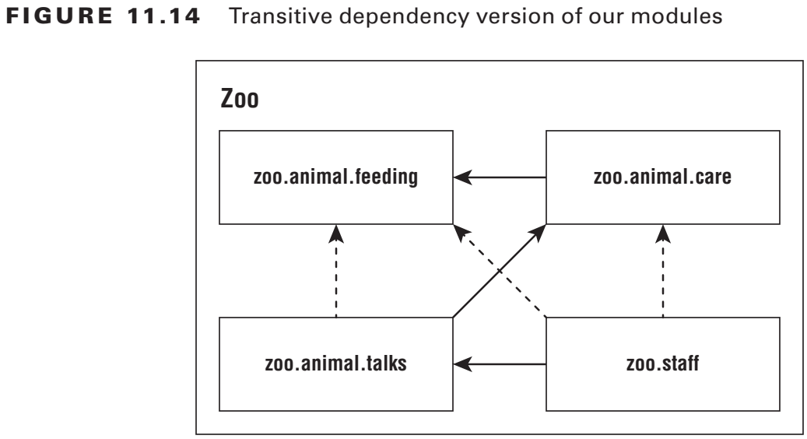
4-Diving into the Module info file
requires transitive Figure 11.14 shows the modules with dashed lines for the redundant relationships and
solid lines for relationships specified in the module-info. This shows how the module
relationships would look if we were to only use
transitive dependencies.

Slide 50
4-Diving into the Module info file
requires transitive For example, zoo.animals.talks depends on zoo.animals.care,
which depends on zoo.animals.feeding. That means the arrow between
zoo.animals.talks and zoo.animals.feeding no longer appears in Figure 11.14. Now let’s look at the four module-info files. The first module
remains unchanged. We are exporting one package to any packages that use the module. module zoo.animal.feeding { exports zoo.animal.feeding; }

Slide 51
4-Diving into the Module info file
requires transitive The zoo.animal.care module is the first opportunity
to improve things. Rather than forcing all remaining modules to explicitly specify
zoo.animal.feeding, the code uses requires transitive. module zoo.animal.care { exports zoo.animal.care.medical; requires transitive zoo.animal.feeding; }

Slide 52
4-Diving into the Module info file
requires transitive In the zoo.animal.talks module, we make a similar change and don’t force other modules to specify zoo.animal.care. We also no longer need to specify zoo.animal.feeding, so that line is commented out. module zoo.animal.talks { exports zoo.animal.talks.content to zoo.animal.staff; exports zoo.animal.talks.media; exports zoo.animal.talks.schedule; // no longer needed requires zoo.animal.feeding; // no longer needed requires zoo.animal.care; requires transitive zoo.animal.care; }

Slide 53
4-Diving into the Module info file
requires transitive Finally, in the zoo.staff module, we can get rid of two requires
statements. module zoo.staff { // no longer needed requires zoo.animal.feeding; // no longer needed requires zoo.animal.care; requires zoo.animal.talks; }
The more modules you have, the more benefits of requires transitive compound. It is also more convenient for the caller. If you were trying to work with this zoo, you could just require zoo.staff and have the remaining dependencies automatically inferred.

Slide 54
4-Diving into the Module info file
Duplicate requires Statements One place the exam might try to trick you is mixing requires and requires transitive together. Can you think of a reason this code doesn’t compile? module bad.module { requires zoo.animal.talks; requires transitive zoo.animal.talks; } Java doesn’t allow you to repeat the same module in a requires clause. It is redundant and most like an error in coding. Keep in mind that requires transitive is like requires plus some extra behavior.

Slide 55
4-Diving into the Module info file
provides, uses, and opens For the remaining three keywords (provides, uses, and opens), you only need to be aware they exist rather than understanding them in detail for the 1Z0-815 exam. The provides keyword specifies that a class provides an implementation of a service. The topic of services is covered on the 1Z0-816 exam, so for now, you can just think of a service as a fancy interface. To use it, you supply the API and class name that implements the API: provides zoo.staff.ZooApi with zoo.staff.ZooImpl The uses keyword specifies that a module is relying on a service. To code it, you supply the API you want to call: uses zoo.staff.ZooApi

Slide 56
4-Diving into the Module info file
provides, uses, and opens Java allows callers to inspect and call code at runtime with a technique called reflection. This is a powerful approach that allows calling code that might not be available at compile time. It can even be used to subvert access control! Don’t worry—you don’t need to know how to write code using reflection for the exam. Since reflection can be dangerous, the module system requires developers to explicitly allow reflection in the module-info if they want calling modules to be allowed to use it. Here are two examples: opens zoo.animal.talks.schedule; opens zoo.animal.talks.media to zoo.staff; The first example allows any module using this one to use reflection. The second example only gives that privilege to the zoo.staff package

Slide 57
5-Discovering Modules
So far, we’ve been working with modules that we wrote. Since Java 9, the classes built into the JDK were modularized as well. In this section, we will show you how to use commands to learn about modules. You do not need to know the output of the commands in this section. You do, however, need to know the syntax of the commands and what they do. We include the output where it facilitates remembering what is going on. But you don’t need to memorize that (which frees up more space in your head to memorize command-line options). The java Command The java command has three module-related options. One describes a module, another lists the available modules, and the third shows the module resolution logic.

Slide 58
5-Discovering Modules
1-Describing a Module Suppose you are given the zoo.animal.feeding module JAR fi le and want to know about its module structure. You could “unjar” it and open the module-info fi le. This would show you that the module exports one package and doesn’t require any modules. module zoo.animal.feeding { exports zoo.animal.feeding; } However, there is an easier way. The java command now has an option to describe a module. The following two commands are equivalent: java -p mods -d zoo.animal.feeding
java -p mods --describe-module zoo.animal.feeding
Each prints information about the module. For example, it might print this: zoo.animal.feeding file:///absolutePath/mods/zoo.animal.feeding.jar exports zoo.animal.feeding requires java.base mandated

Slide 59
5-Discovering Modules
1-Describing a Module
The first line is the module we asked about: zoo.animal.feeding. The second line starts information about the module. In our case, it is the same package exports statement we had in the module-info file. On the third line, we see requires java.base mandated. Now wait a minute. The module-info file very clearly does not specify any modules that zoo.animal.feeding has as
dependencies. The java.base module is special. It is automatically added as a dependency to all modules. This module has frequently used packages like java.util. That’s what the mandated is about. You get java.base whether you asked for it or not. In classes, the java.lang package is automatically imported whether you type it or not. The java.base module works the same way. It is automatically available to all other modules

Slide 60
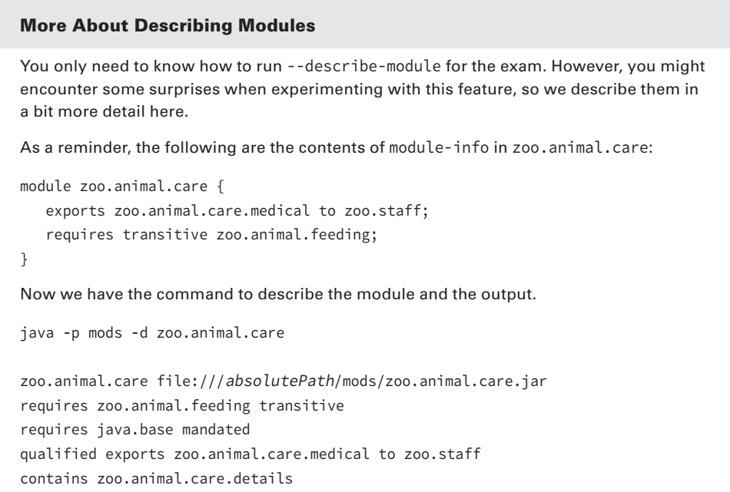
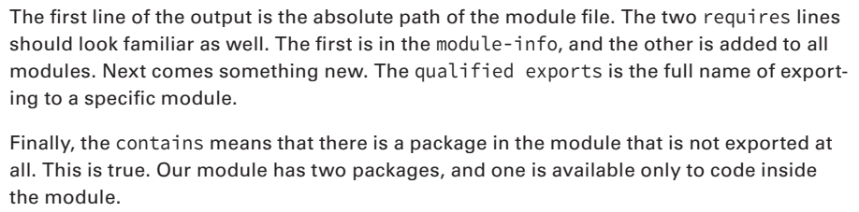
5-Discovering Modules

Slide 61
5-Discovering Modules
2-Listing Available Modules In addition to describing modules, you can use the java command to list the modules that are available. The simplest form lists the modules that are part of the JDK: java --list-modules When we ran it, the output went on for 70 lines and looked like this: java.base@11.0.2 java.compiler@11.0.2 java.datatransfer@11.0.2 This is a listing of all the modules that come with Java and their version numbers. You can tell that we were using Java 11.0.2 when testing this example. More interestingly, you can use this command with custom code. Let’s try again with the directory containing our zoo modules. java -p mods --list-modules

Slide 62
5-Discovering Modules
2-Listing Available Modules
How many lines do you expect to be in the output this time? There are 74 lines now: the 70 built-in modules plus the four in our zoo system. The custom lines look like this: zoo.animal.care file:///absolutePath/mods/zoo.animal.care.jar zoo.animal.feeding file:///absolutePath/mods/zoo.animal.feeding.jar zoo.animal.talks file:///absolutePath/mods/zoo.animal.talks.jar zoo.staff file:///absolutePath/mods/zoo.staff.jar Since these are custom modules, we get a location on the fi le system. If the project had a module version number, it would have both the version number and the fi le system path.

Slide 63
5-Discovering Modules
3-Showing Module Resolution In case listing the modules didn’t give you enough output, you can also use the --show-module-resolution option. You can think of it as a way of debugging modules. It spits out a lot of output when the program starts up. Then it runs the program. java --show-module-resolution -p feeding -m zoo.animal.feeding/zoo.animal.feeding.Task

Slide 64
5-Discovering Modules
3-Showing Module Resolution Luckily you don’t need to understand this output. That said, having seen it will make it easier to remember. Here’s a snippet of the output: root zoo.animal.feeding file:///absolutePath/feeding/ java.base binds java.desktop jrt:/java.desktop java.base binds jdk.jartool jrt:/jdk.jartool ... jdk.security.auth requires java.naming jrt:/java.naming jdk.security.auth requires java.security.jgss jrt:/java.security.jgss ... All fed! It starts out by listing the root module. That’s the one we are running: zoo.animal .feeding. Then it lists many lines of packages included by the mandatory java.base module. After a while, it lists modules that have dependencies. Finally, it outputs the result of the program All fed!. The total output of this command is 66 lines.

Slide 65
5-Discovering Modules
3-Showing Module Resolution Luckily you don’t need to understand this output. That said, having seen it will make it easier to remember. Here’s a snippet of the output: root zoo.animal.feeding file:///absolutePath/feeding/ java.base binds java.desktop jrt:/java.desktop java.base binds jdk.jartool jrt:/jdk.jartool ... jdk.security.auth requires java.naming jrt:/java.naming jdk.security.auth requires java.security.jgss jrt:/java.security.jgss ... All fed! It starts out by listing the root module. That’s the one we are running: zoo.animal .feeding. Then it lists many lines of packages included by the mandatory java.base module. After a while, it lists modules that have dependencies. Finally, it outputs the result of the program All fed!. The total output of this command is 66 lines.

Slide 66
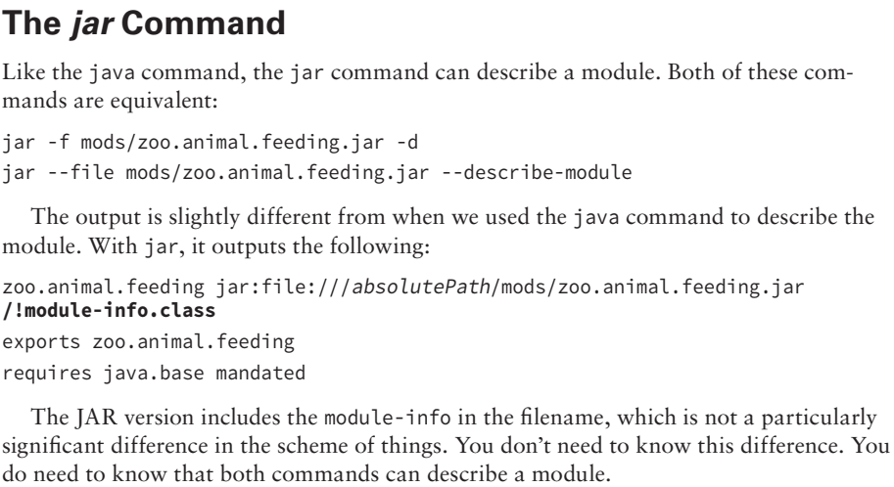
5-Discovering Modules

Slide 67
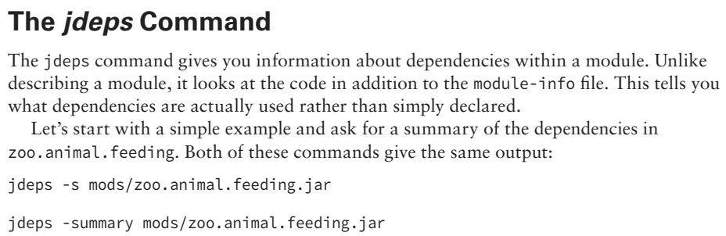
5-Discovering Modules

Slide 68
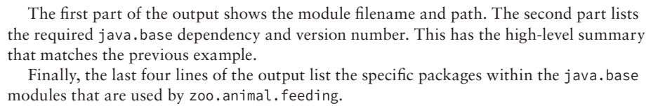
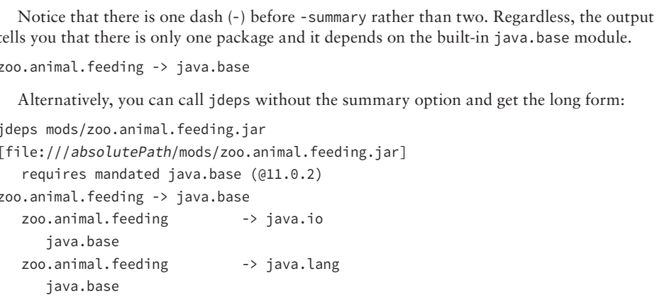
5-Discovering Modules

Slide 69
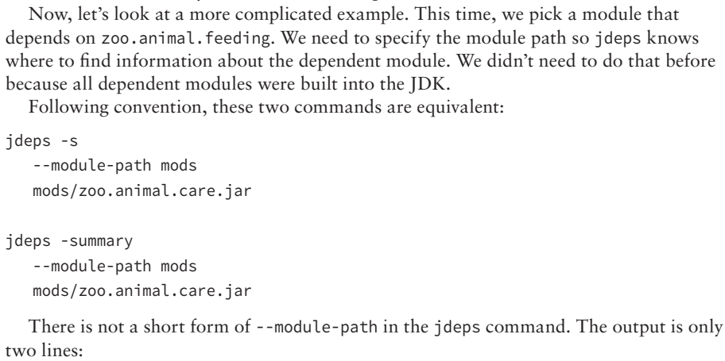
5-Discovering Modules

Slide 70
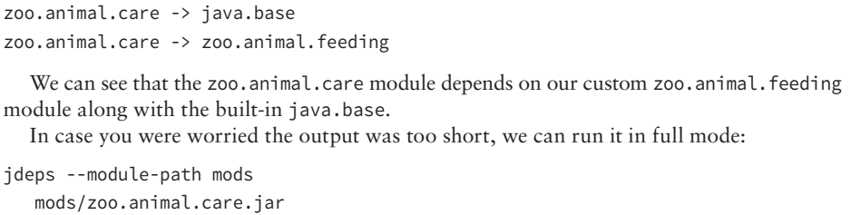
5-Discovering Modules

Slide 71
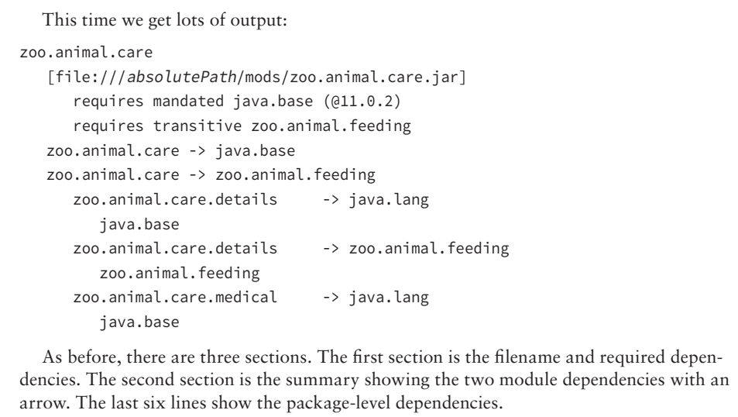
5-Discovering Modules

Slide 72
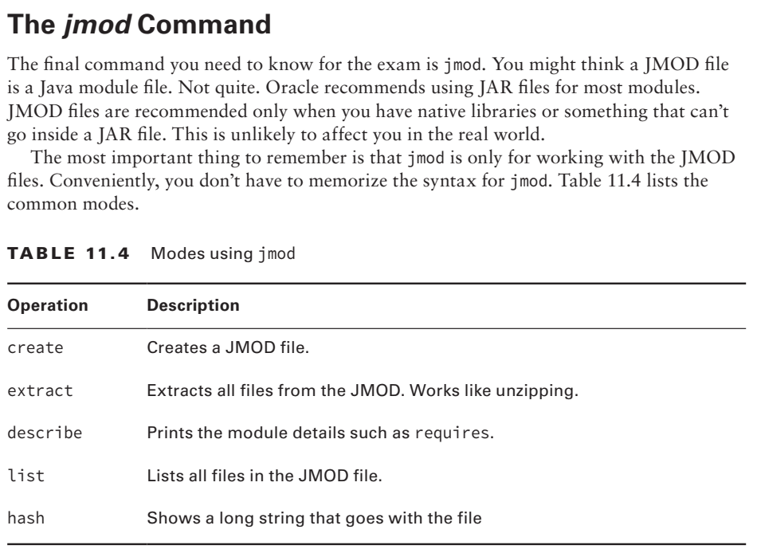
5-Discovering Modules

Slide 73
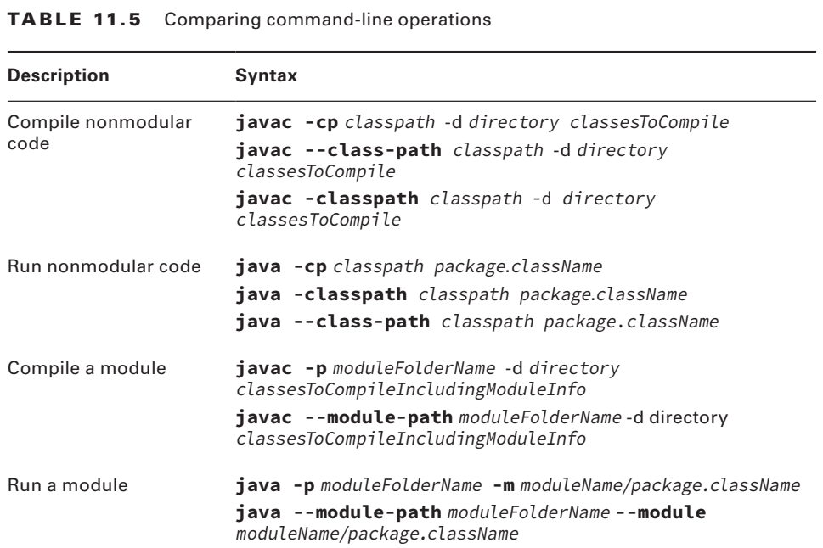
6-Reviewing Command-Line Options

Slide 74
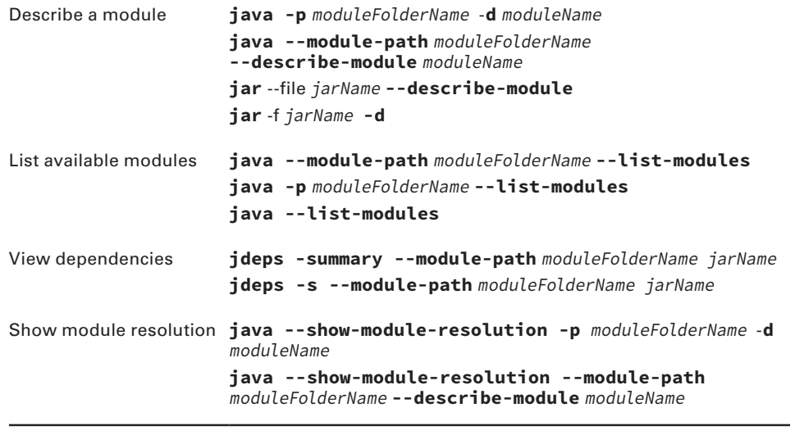
6-Reviewing Command-Line Options

Slide 75
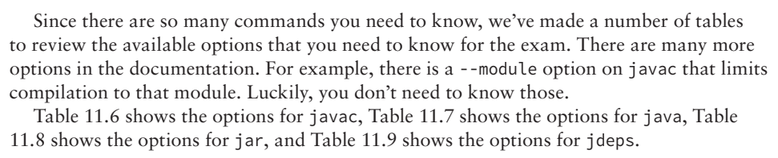
6-Reviewing Command-Line Options

Slide 76
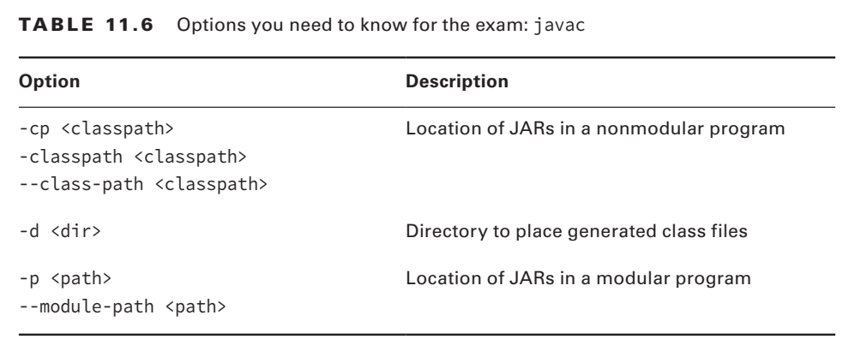
6-Reviewing Command-Line Options

Slide 77
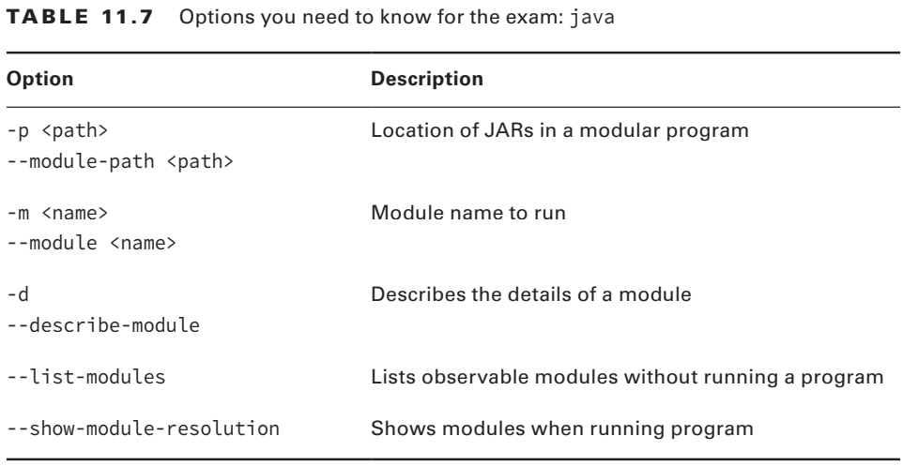
6-Reviewing Command-Line Options

Slide 78
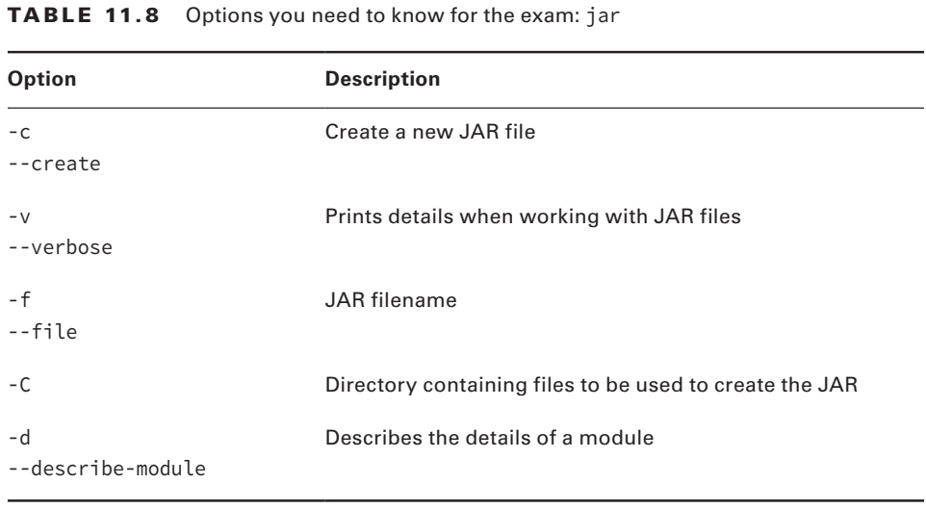
6-Reviewing Command-Line Options

Slide 79
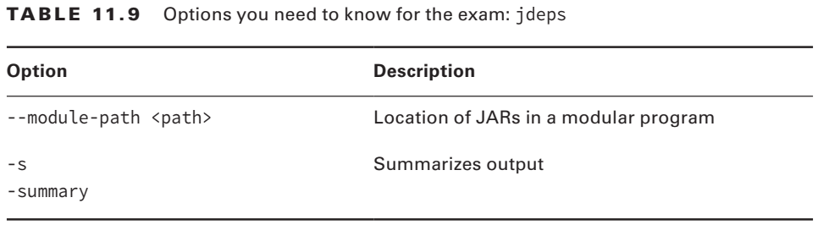
6-Reviewing Command-Line Options

